Slide 1

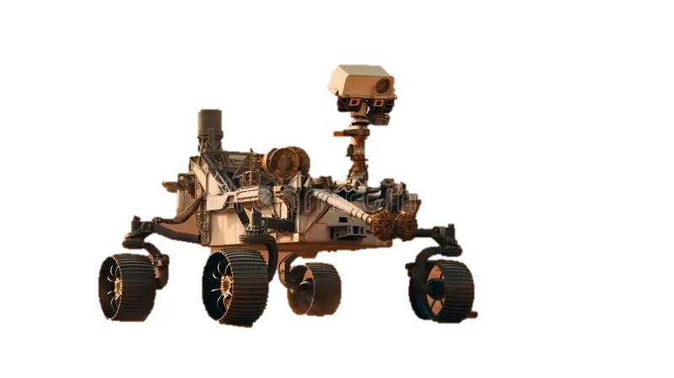

ROVER DESIGN FOR EXTREME TERRAIN EXPLORATION ON MARS
BY – TEAM P PALLAVI.N
AND
PRATHIMA .P

Slide 2
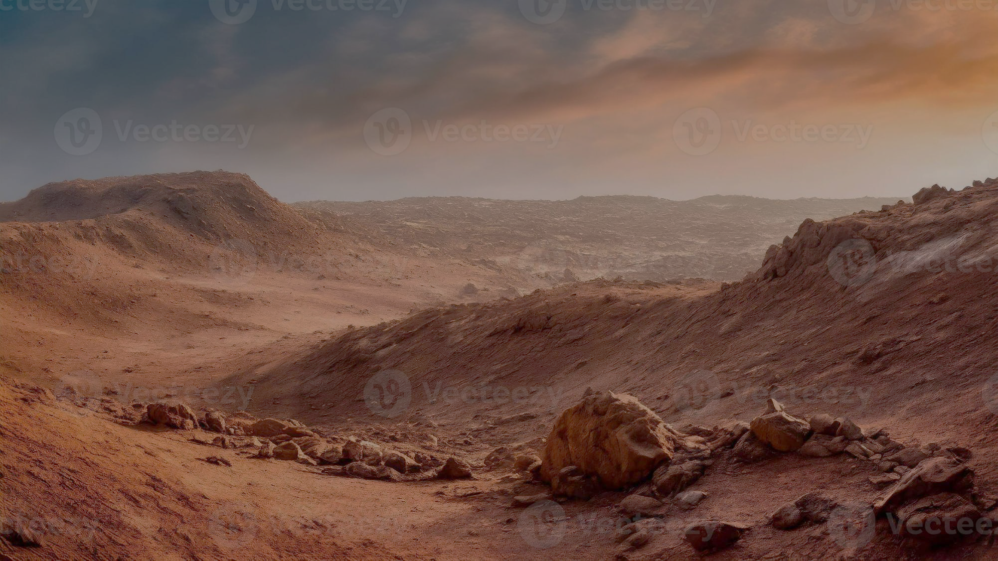
INTRODUCTION
Mars is the most Earth-like planet in our solar system.
Rovers are robotic explorers designed to survive and study harsh Martian conditions.
They pave the way for human exploration and scientific discovery.

Slide 3



OBJECTIVES
Design a rover capable of extreme terrain mobility.
Ensure survival in harsh Martian climate.
Carry advanced instruments for science and exploration.

Slide 4
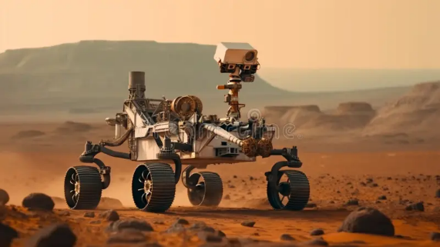
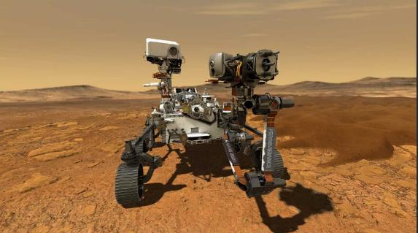
NASA FLAGSHIP ROVERS : CURIOSITY VS PERSEVERANCE
CURIOSITY
(2012 – PRESENT )
PERSEVERANCE
(2021 – PRESENT)
Landed in Gale Crater.
Main Goal: Study habitability.
Power: RTG (nuclear).
Key Discoveries: Ancient riverbeds, organic molecules, methane.
Landed in Jezero Crater.
Main Goal: Search for ancient life.
Power: RTG + better instruments.
Unique: MOXIE experiment, Ingenuity helicopter, sample caching.

Slide 5
HARSH CONDITIONS FACED BY ROVERS ON MARS
1. Extreme Temperatures :
Mars temperature ranges from +20°C (day) to –125°C (night).
Electronics, batteries, and instruments must be kept warm inside with special heaters.
2. Dust Storms :
Fine Martian dust covers solar panels, lenses, and joints.
Global dust storms can block sunlight for weeks, making operations difficult.
Dust can scratch instruments and cause moving parts to jam.
3. Thin Atmosphere
Mars atmosphere is ~100 times thinner than Earth’s (mostly CO₂).
Little protection from cosmic radiation and solar storms.
Makes parachute-based landings extremely challenging.
4. Rough Terrain
Sharp rocks, soft sand, and craters can trap rovers (like Spirit rover in 2009).
Wheels experience wear and tear from driving over jagged rocks.

Slide 6
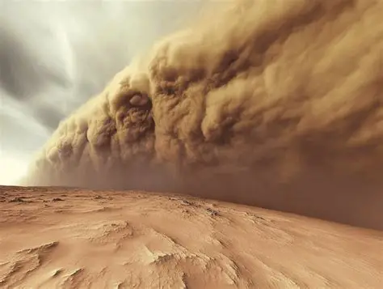
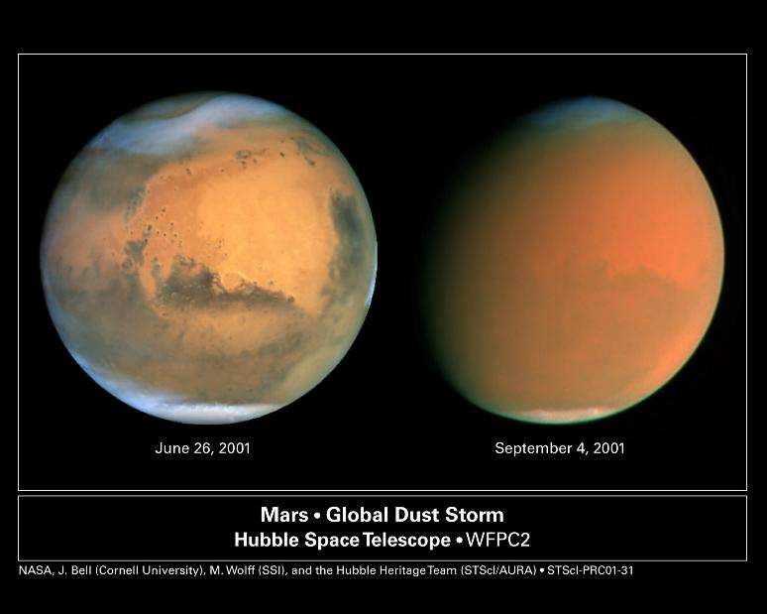
5. Communication Delay :
10–20 minutes between Earth and Mars.
6. High Radiation Levels :
can harm electronics and sensors.

Slide 7
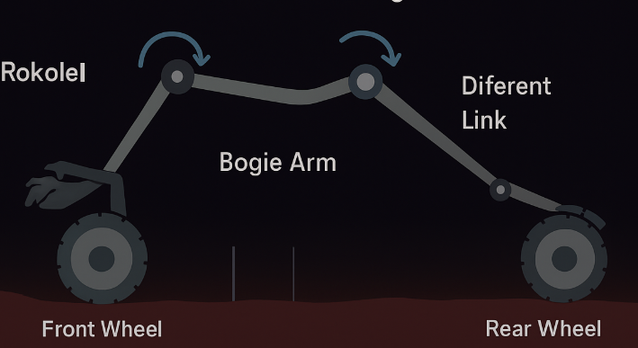
Rover Design: Mobility & Suspension Systems
Rocker-Bogie Suspension: Balances on uneven ground without tipping.
Flexible Wheels: Withstand sharp rocks and soft sand.
Ground Clearance: Prevents bottom scraping on obstacles.
Motors: Six independently driven wheels for stability.

Slide 8
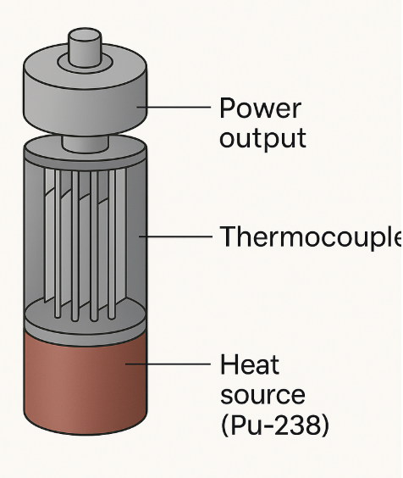
Powering the Rovers: Energy for Survival
Radioisotope Thermoelectric Generator (RTG): Converts heat from plutonium into electricity.
Reliable Power Source: Works day and night, unaffected by dust storms.
Rechargeable Batteries: Store excess power for peak demand.
Thermal Control: Waste heat keeps instruments warm.

Slide 9
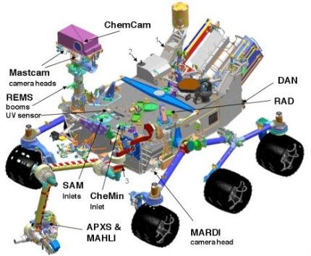
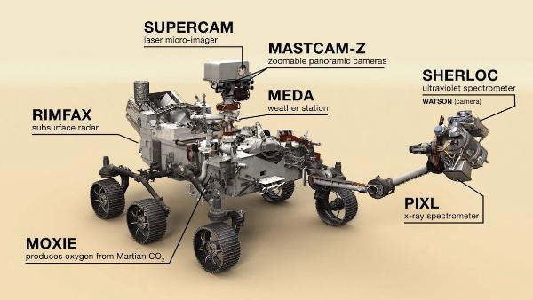
Scientific Instruments And Sensors
CURIOSITY ROVER
PERSEVERANCE ROVER
ChemCam: Laser + camera for rock composition.
SAM (Sample Analysis): Detects organic molecules.
MastCam: Panoramic imaging system.
PIXL: Chemical element mapping.
SHERLOC: Detects biosignatures.
MOXIE: Produces oxygen from CO₂.

Slide 10
CONCLUSION
Rovers like Curiosity and Perseverance help us understand Mars’ past and prepare for future human exploration.
Each rover is uniquely designed for survival, mobility, and advanced scientific research.
Perseverance’s sample collection and Ingenuity helicopter mark the next step in Mars exploration.
Engineering innovations from past missions guide the design of future rovers.
Mars exploration is a continuous journey — combining science, technology, and human curiosity.

Slide 11
THANK YOU

